Slide 1

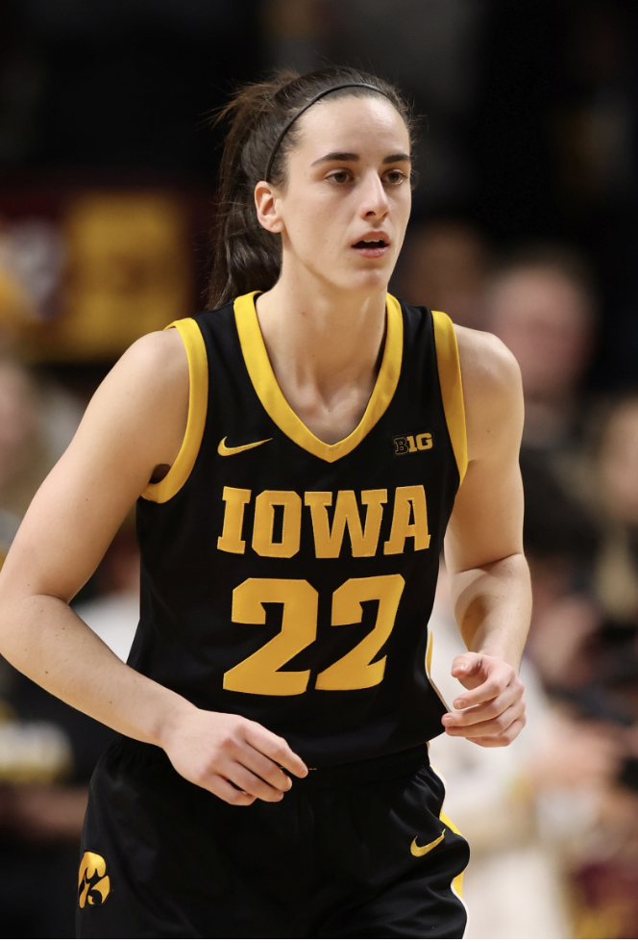



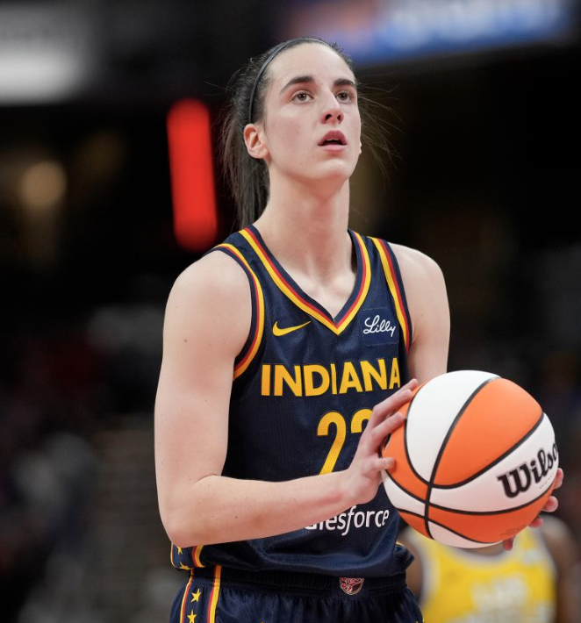
Identifying Differences in WNBA vs. NBA Roster Construction and Strategy
Team 5 - Graeme Ashley, Jose Smith, Timothy Wijaya

Slide 2
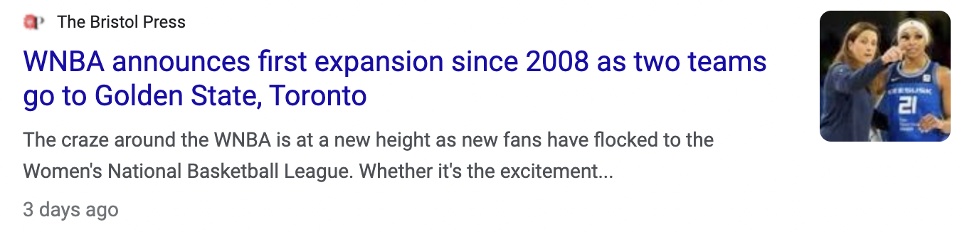
WNBA Expansion Presents New Challenges
Expansion teams will try to optimally construct their rosters with draft picks and free agency signings
Pick out winning metrics and strategies
Identifying overarching trends in gameplay evolution

Slide 3
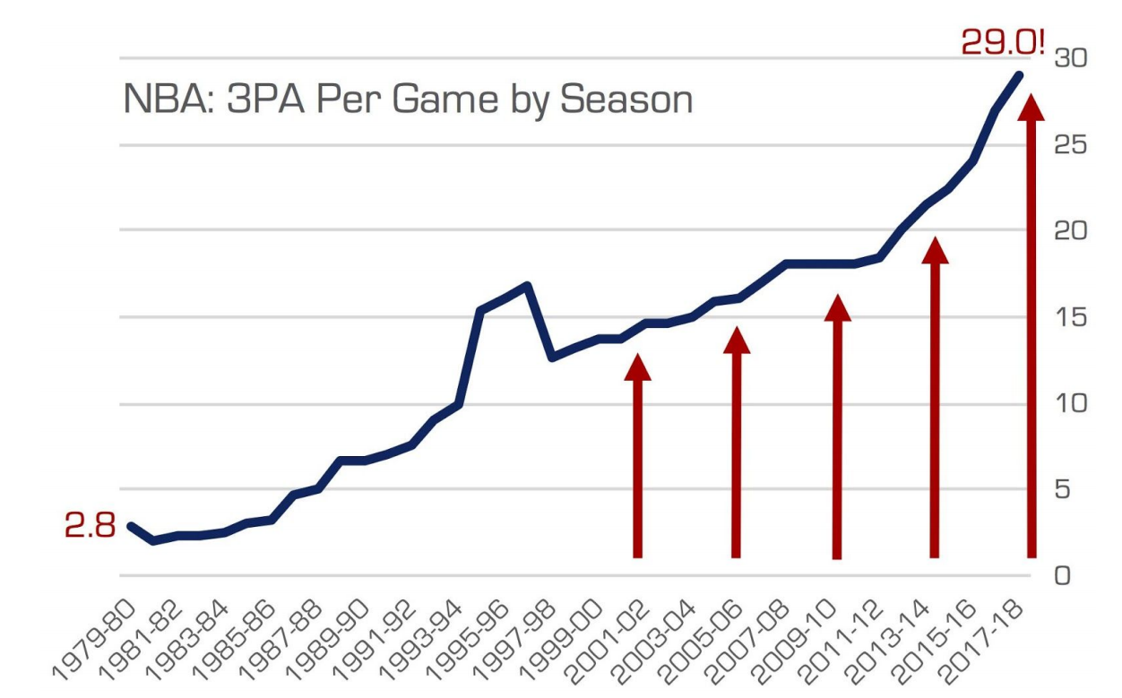

Using the NBA as a Guide
NBA has focused roster construction around two key areas since the mid-2010s:
Three point shooting
Positionless basketball
We will seek to uncover if this template for roster construction translates to success in the WNBA, or if WNBA teams should identify different strategies that translate to wins.

Slide 4
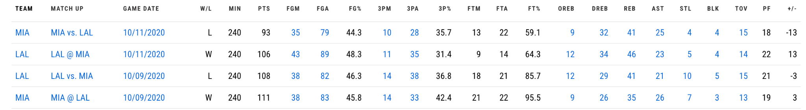
Data Sources
NBA box scores from 2003 - present, scraped from NBA.com
WNBA box scores from 2003 - present, scraped from WNBA.com

Slide 5
Methodology
Regression - Multilinear Regression, Ensemble Methods
Predicting total wins in a season to see which metrics contribute most to wins
Will need to aggregate box score data by team
Predicting actual scores, point differential, offensive / defensive rating
See which factors contribute most to scoring and limiting opponents points
Classification - Logistic Regression, Ensemble Methods
Predicting win probability in individual games
Identify which metrics contribute most to win probability
How have the importance of these metrics evolved over the years?
Plot time series data to show how metrics have increased / decreased in importance over time

Slide 6
Tentative Timeline
Weeks 1-2:
Problem formulation
Data collection/parsing, preliminary data cleaning & exploratory analysis.
Potential conversations of box score data per 100 Possessions? (adjust for Pace)
Preliminary literature review
Weeks 3-4: Exploratory Data analysis
Finish Cleaning Data
Finish exploratory analysis
Begin to build out models
Feature Engineering
Weeks 5-6:
Build out various models on data, decide whether a single best model, or combination of various models may work better
Test out models by comparing to KPIs
Week 7-8:
Further refining of models
Build out conclusions from collected data and analysis

Slide 7
Areas of Concern/Other data sources
If Conclusions don’t seem viable or practical -
Potential Other Data sources
potential for usage of other data sets with more advanced box scores or player skill data (Such as BBI.com) as a potential secondary conclusion. Will only be available for the NBA.

Slide 8
KPIs
Point differential
Points allowed per 40 mins (WNBA) or 48 mins (NBA)
Off/Def RTG (Points per game / points allowed per 100 possessions)
Three point shooting
Free throw shooting
Defensive metrics (blocks/game, steals/game, turnovers forced per possession)

